Slide 1
Outdoor survival
By ross young, Elisabeth Hansen
Nebraska game and parks

Slide 2
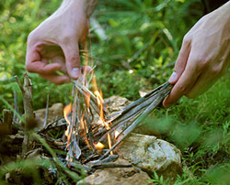
WHAT WE WILL LEARN TODAY:
Why are survival skills needed?
Identify five basic skills for survival

Slide 3
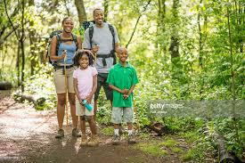
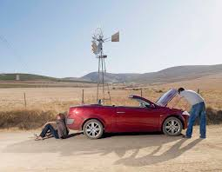
Why are survival skills needed?
Something could happen to anyone…
An experienced outdoor person
Family on a leisurely hike
Vehicle problem in a rural area

Slide 4
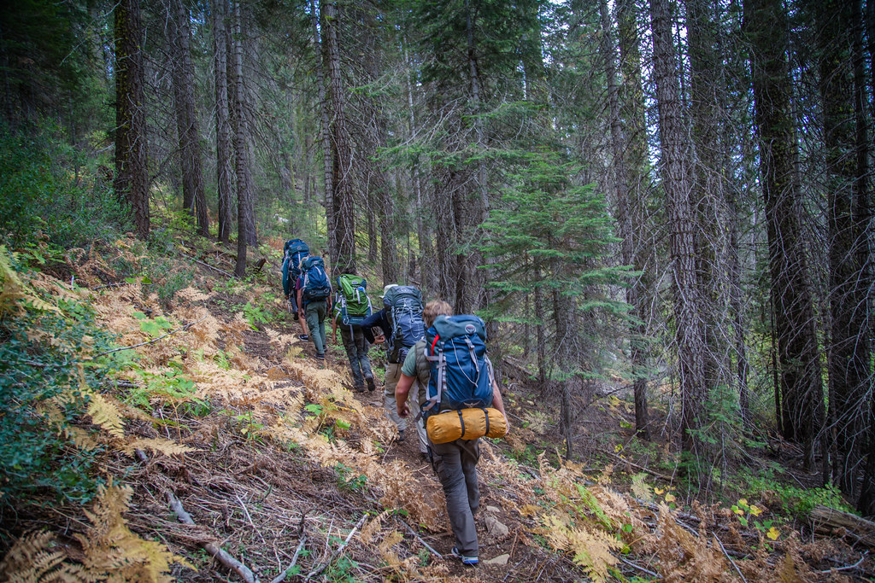
HOW TO AVOID A SURVIVAL SITUATION
Don’t go alone
Tell someone where you are going and when you plan to return
Know your location on the map
Stay on trails and routes
Learn basic outdoor survival skills

Slide 5
DO NOT PANIC
Mindset to survive
STOP
S- STOP
T- THINK
O- OBSERVE
P- Plan

Slide 6
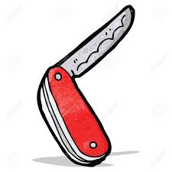
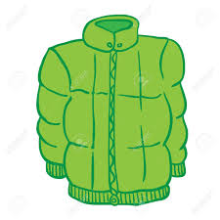
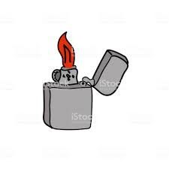
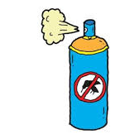
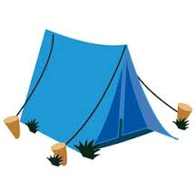
Survival Gear
Flashlight
Water bottle
Snacks
First aid kit
Map
Compass
Insect repellent
Knife
Sunscreen
Fix it
Extra layer
Toilet Paper
Fire
Bandana
Shelter
Let someone know

Slide 7
What can humans live LONGER WITHOUT?
Food or Water?
ANSWER: Food

Slide 9
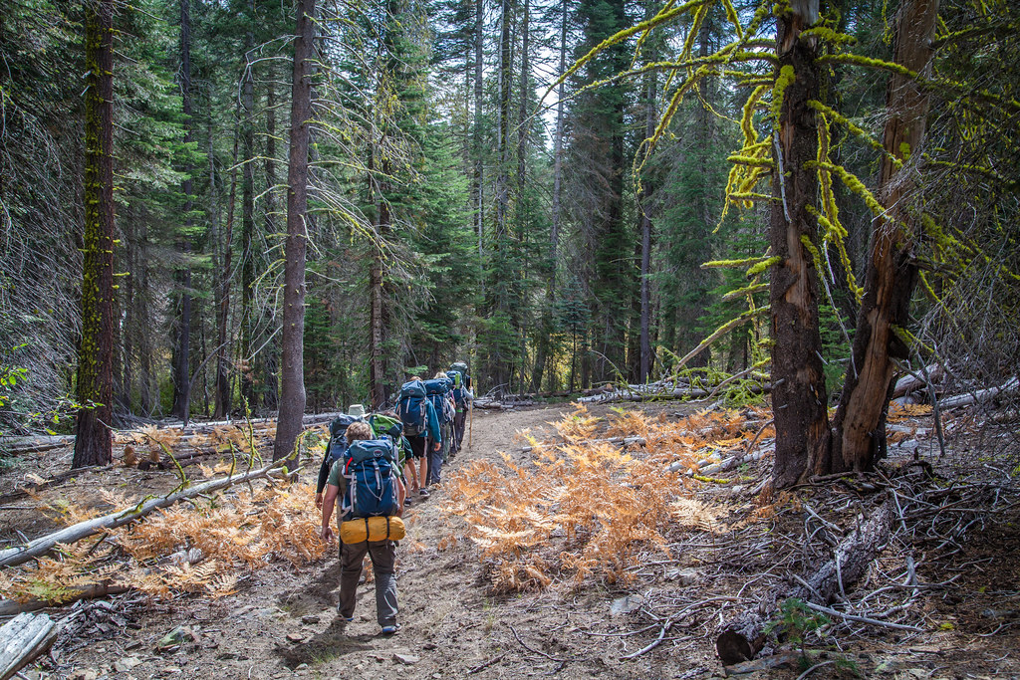
5 basic survival needs
Water
Shelter
Fire
Food
Signal

Slide 10
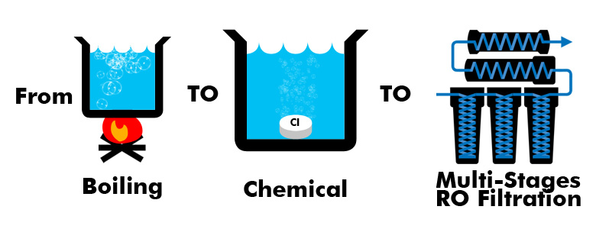
Water
Treat natural water before drinking. Even if it looks clean.
Boil water for at least 5 minutes
Chemical Treatments
Filter System

Slide 11
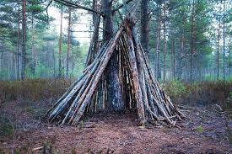
SHELTER
Protects you from:
Sun
Rain
Snow
Cold
Wind
Animals

Slide 12
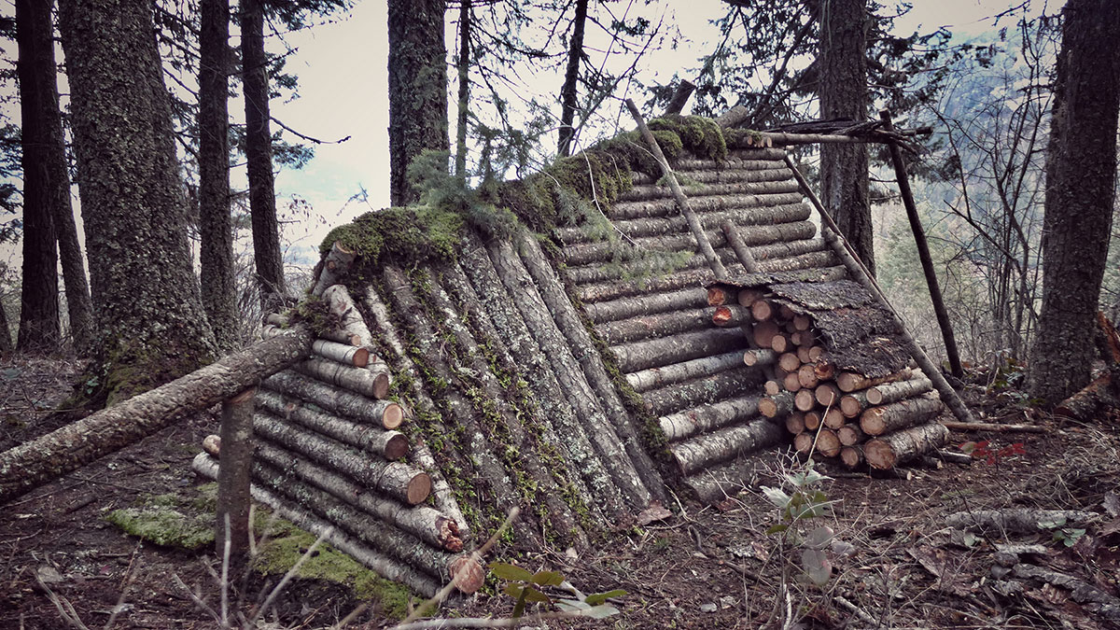
Shelter Types
Temporary
Lean-To
Long-term
Log Cabin

Slide 13
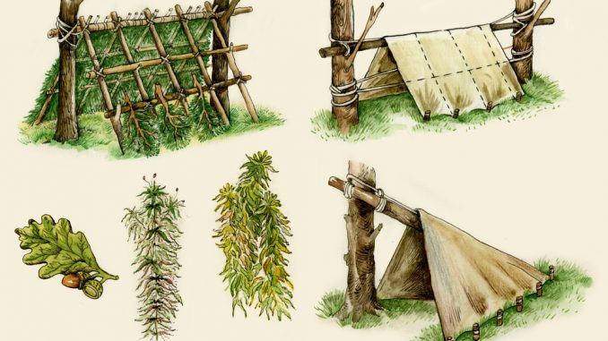
Shelter
Useful Shelter Tools:
--Paracord
--Tarp
--Saw (need different sizes of logs)

Slide 14
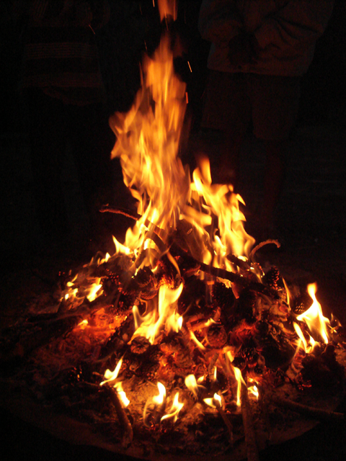
Fire
Warmth
Cooking
Clean Water
Signal for Help

Slide 15
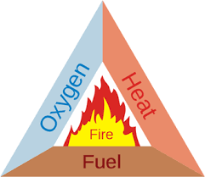
Fire elements
Oxygen
Fuel
Heat

Slide 16
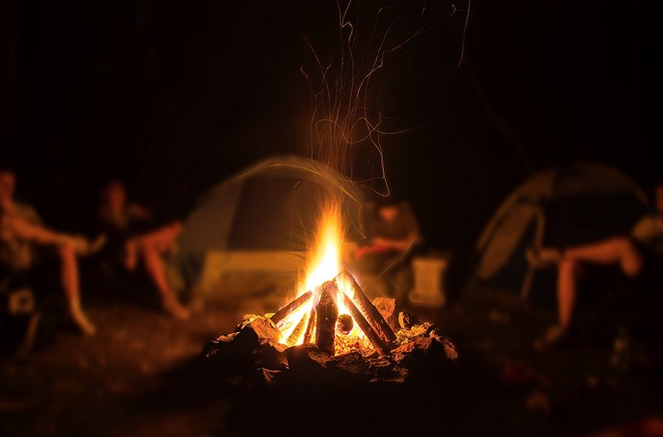
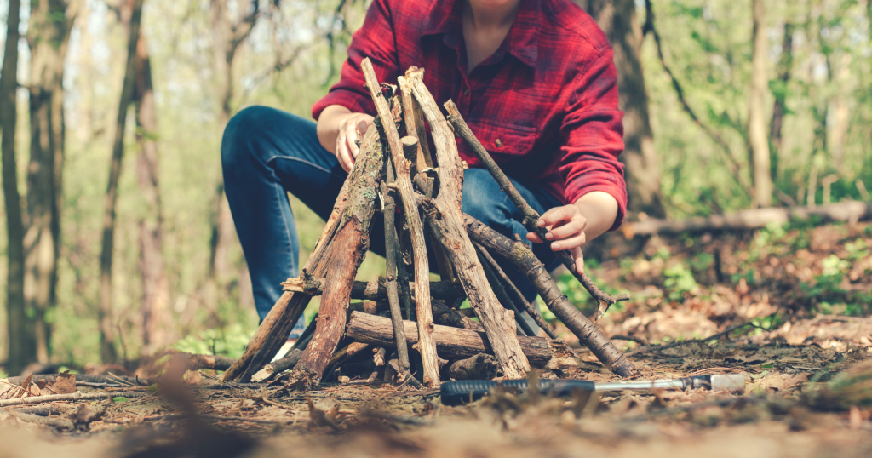
FIRE SAFETY
Safe site
Open area
10ft away from trees
Completely extinguish fire
Build it on
Plain dirt
Sand/gravel
Rock
Greenwood
FIND MORE FIRE SAFETY TIPS AT SMOKEYBEAR.COM

Slide 17
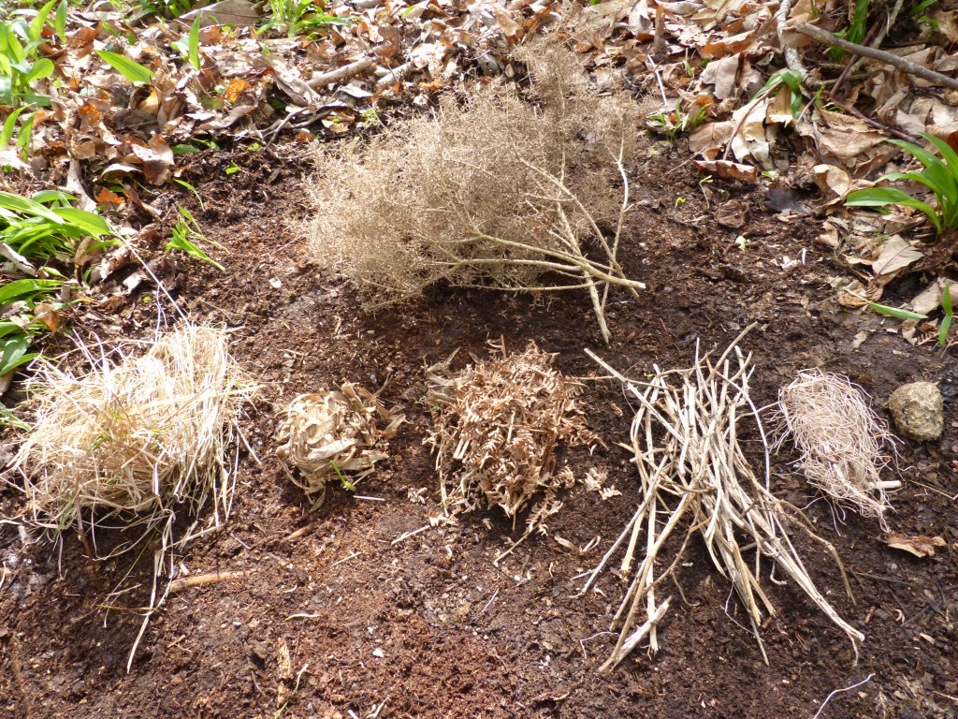
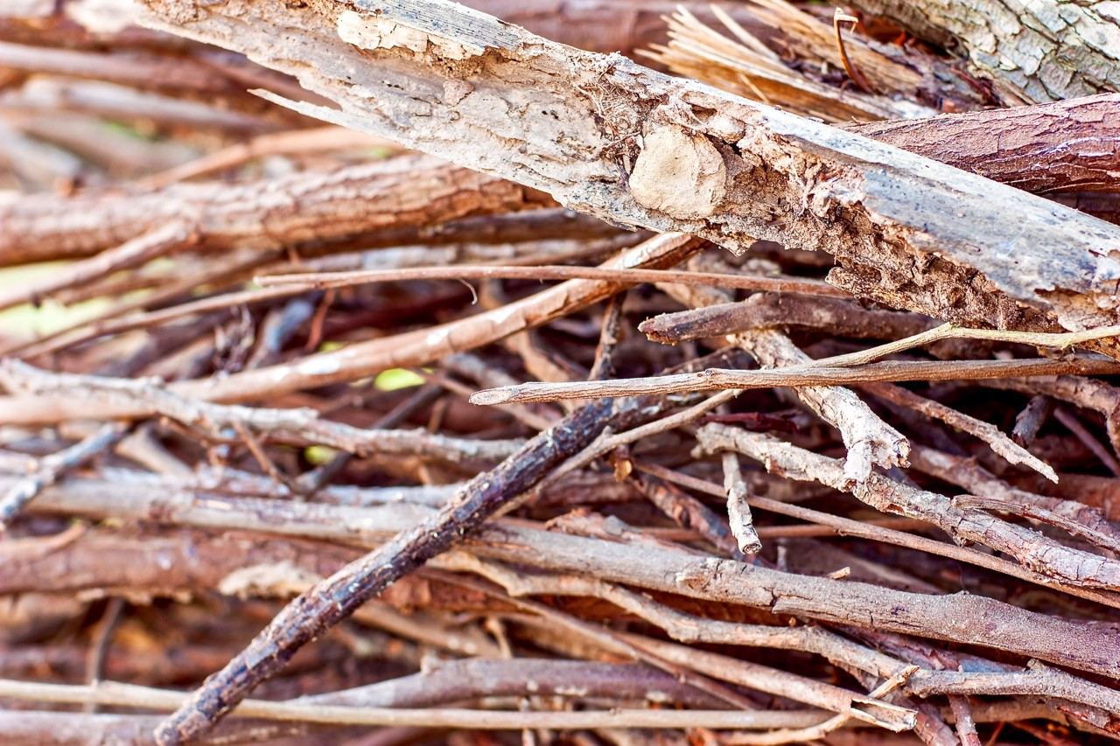
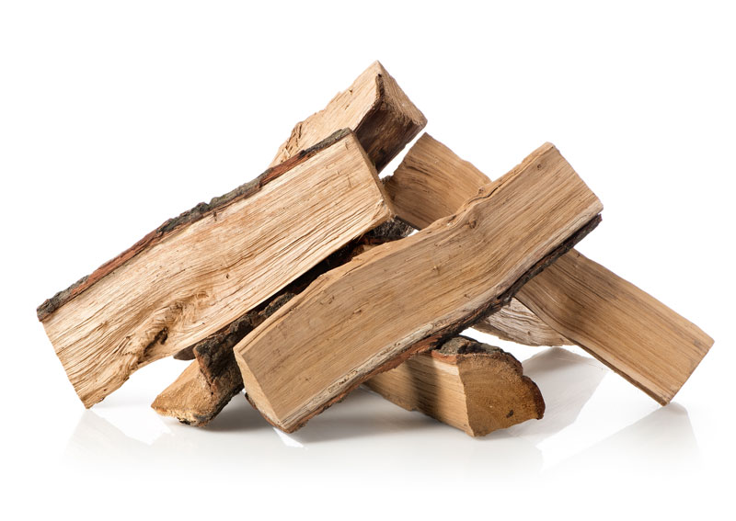
Fire Materials
Tinder –toothpick sized
Dry leaves
Kindling –penciled sized
Small sticks
Small branches
Fuel
Small to medium branches
Logs

Slide 18
Fire starters
Matches
Lighters
Fire by friction-heat
Ferro Rod
Batteries and steel wool

Slide 20
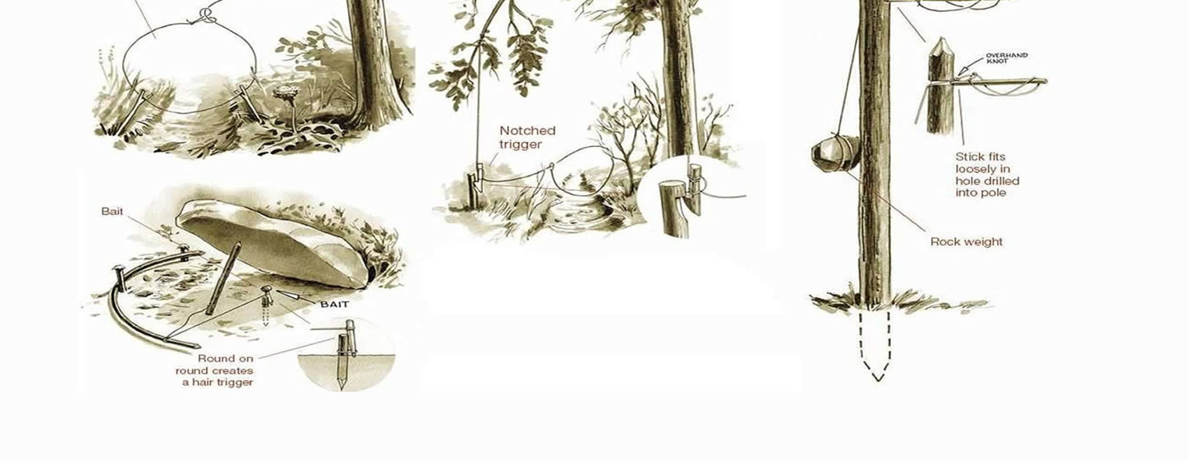
Food
Vegetation
Insects
(Grasshoppers/Crickets)
high in protein
Fish
Birds
Mammals

Slide 21
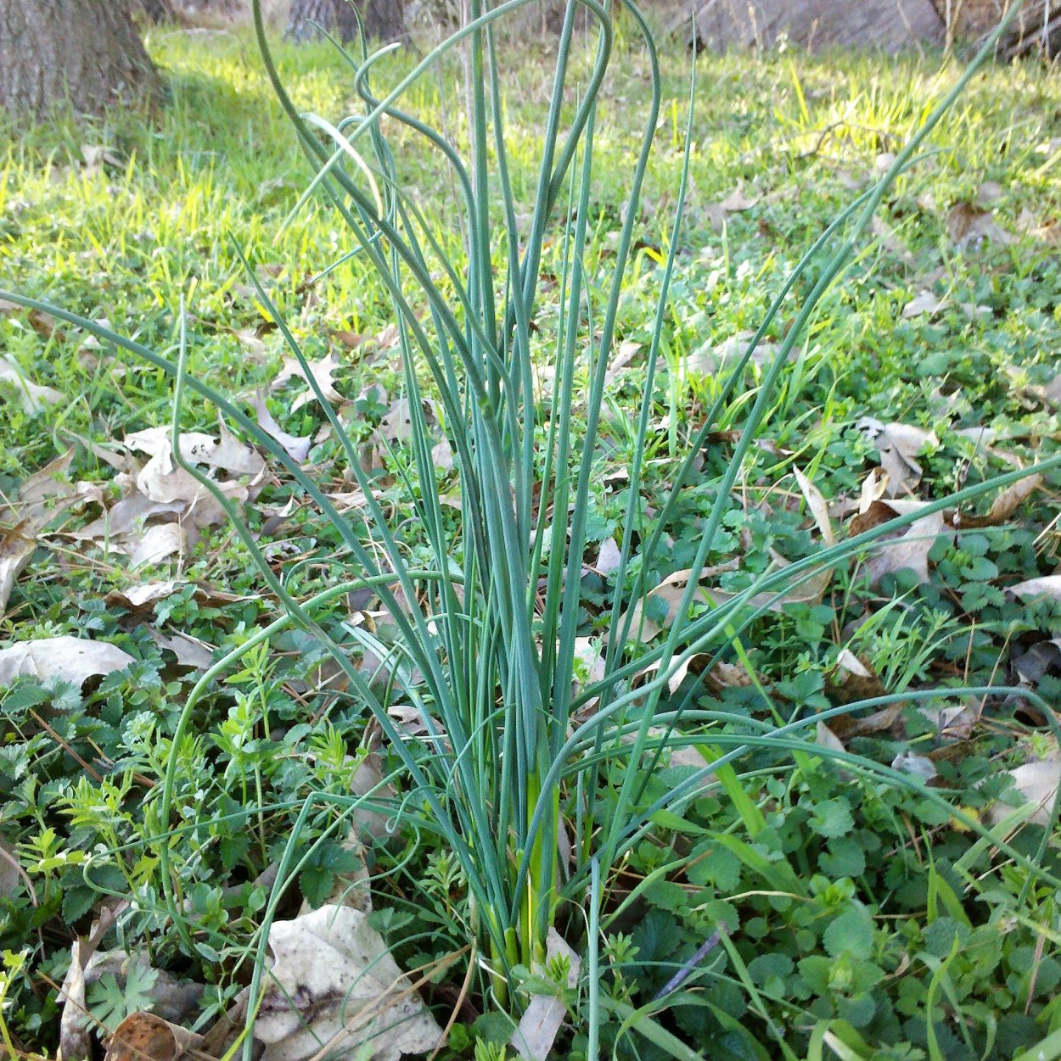
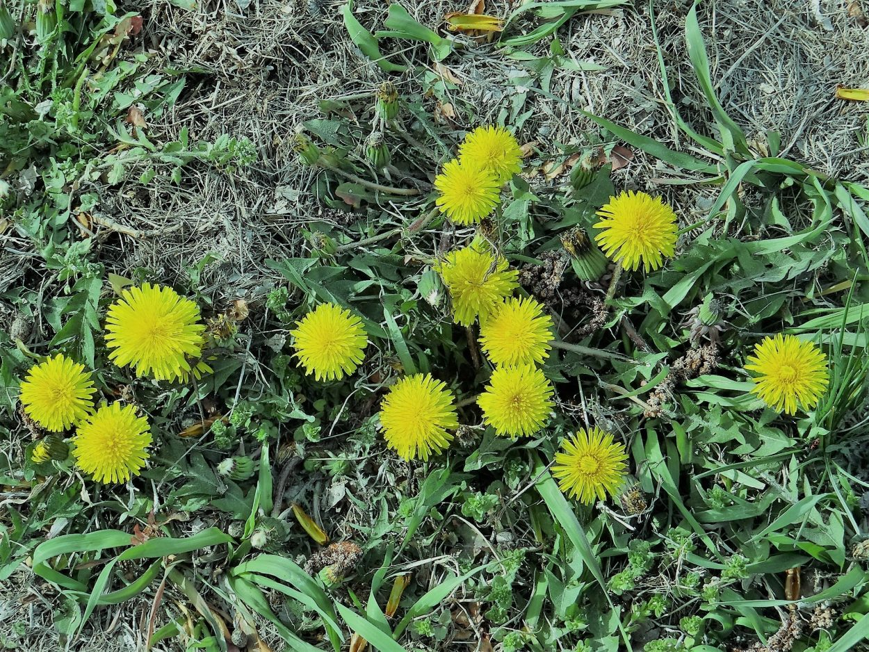
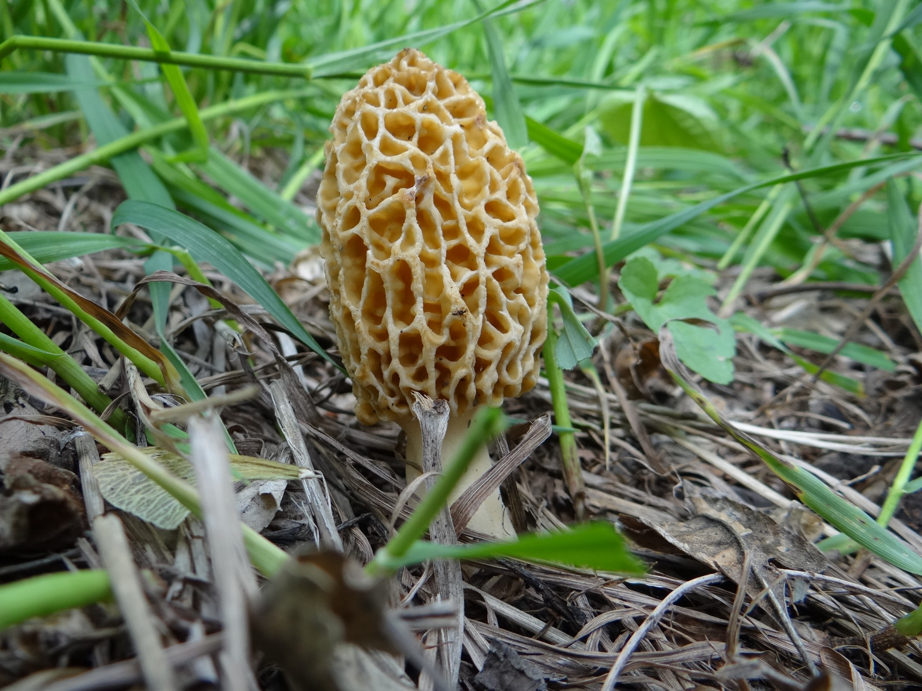
Wild Edibles
**Never eat any wild plant unless you are absolutely sure it is edible!

Slide 22
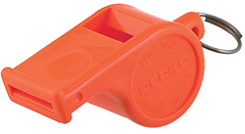
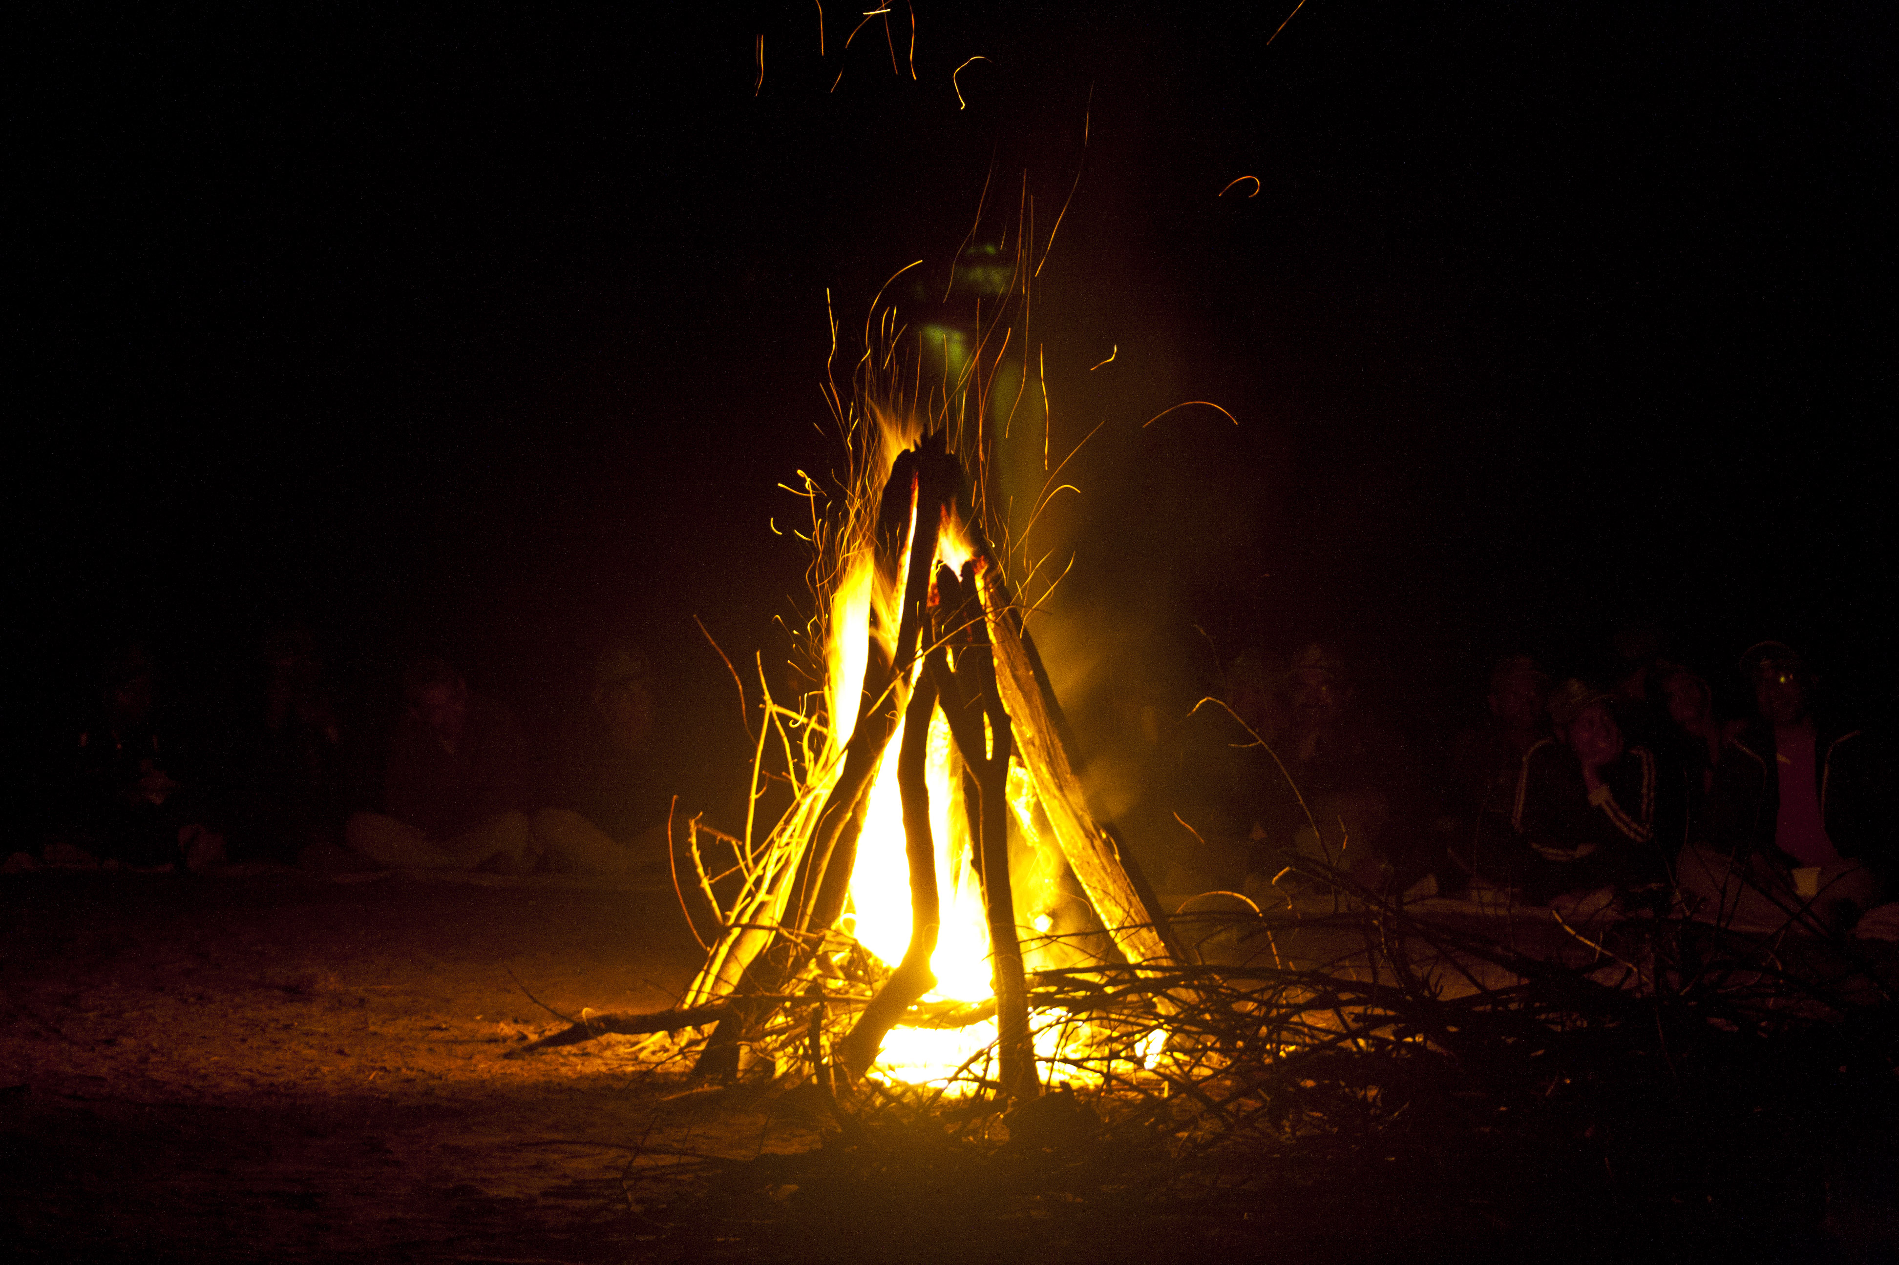
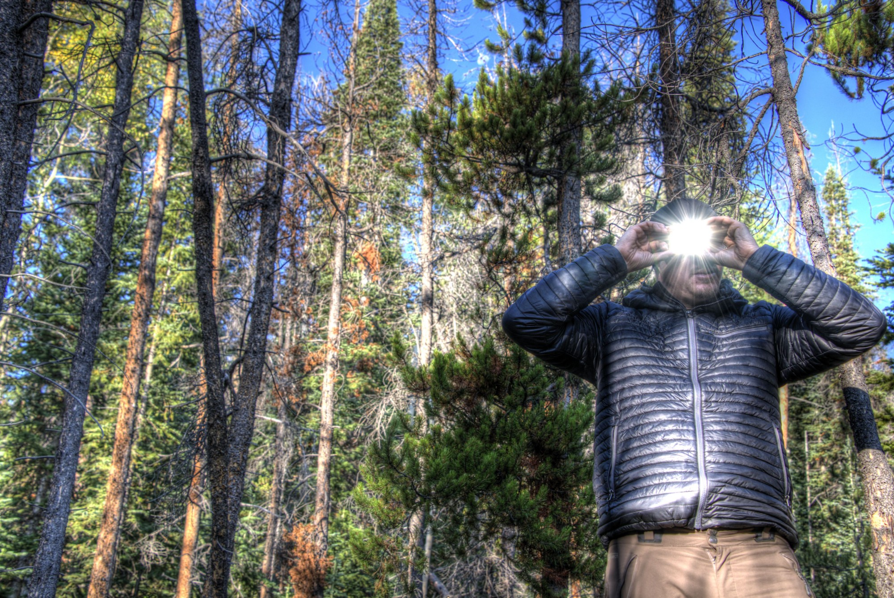
SIGNAL
Whistle—3 blasts
Fire
GPS Location Device
Mirror, reflect
Flashlight
Hit stones together

Slide 23
Ask yourself…..
Why are survival skills are needed?
What are the five basic needs for survival?

Slide 24
SOURCES
https://www.pioneerbushcraft.org/
https://www.rei.com
https://frontierfirewoodnj.com/
www.swifttips.com
https://www.atlasandboots.com
http://www.truthsurvival.com/how-to-build-a-survival-shelter/
https://www.primalsurvivor.net/wilderness-survival-shelter-no-supplies/
http://offgridwarrior.com/winter-survival-shelter-prepping-for-snow/
https://coyotetrails.org/class/survival-shelters-january-29-2017/
http://magazine.outdoornebraska.gov/tag/wild-edibles/
https://survivalist101.com/tutorials/survival-trapping-101/3/
http://woodlineadventures.com/basic-outdoor-survival-skills-boss.html
https://unchartedsupplyco.com/blogs/news/basic-survival-skills

